Slide 1
Why do birds fly in a ‘V’ formation?

Slide 2
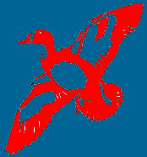
Compared to a single bird flying alone, a flock of birds flying in a ‘V’ formation derives a 71% increase in flying efficiency!

Slide 3
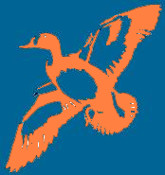
If a bird leaves the formation, it experiences more air-resistance.

Slide 4
The bird quickly returns to the formation, and benefits by the combined power of the flock.

Slide 5
When the leader bird gets tired …

Slide 6
… it goes to the end of the formation.
Another bird takes its place, and begins to lead.

Slide 7
The birds flying in a ‘V’ formation honk to encourage each other.
In that way, they maintain the enthusiasm and speed.

Slide 8
When a bird gets sick, or is injured, or gets tired …

Slide 9
and must leave the formation …

Slide 10
… a few more birds leave the formation and fly with the ailing bird to help and protect it.
They remain with it until it is able to fly again normally.
They reach their group, or just make a new ‘V’ formation.

Slide 11
Thus, the birds teach us about ‘WE’ formation.
Lesson 1
Working as a team, and sharing the same direction, we can reach our destination faster and easier.

Slide 12
Lesson 2
By staying in tune with others, and being inclined to offer and accept help, we create a synergy, and become much more productive.

Slide 13
Lesson 3
To share the leadership, there must be mutual respect amongst all of us.

Slide 14
Lesson 4
Timely words of encoragement motivate everyone, and produce the best of benefits.

Slide 15
Lesson 5
Let us stay beside each other, no matter what the differences might be, especially in times of difficulty and challenges.

Slide 16
HAVE A GREAT DAY!

